Slide 1
How to get the most out of Being a mentEE
Kelly Jordan-Sciutto, PHD
Associate Dean for Graduate Education, PSOM, UPENN

Slide 2
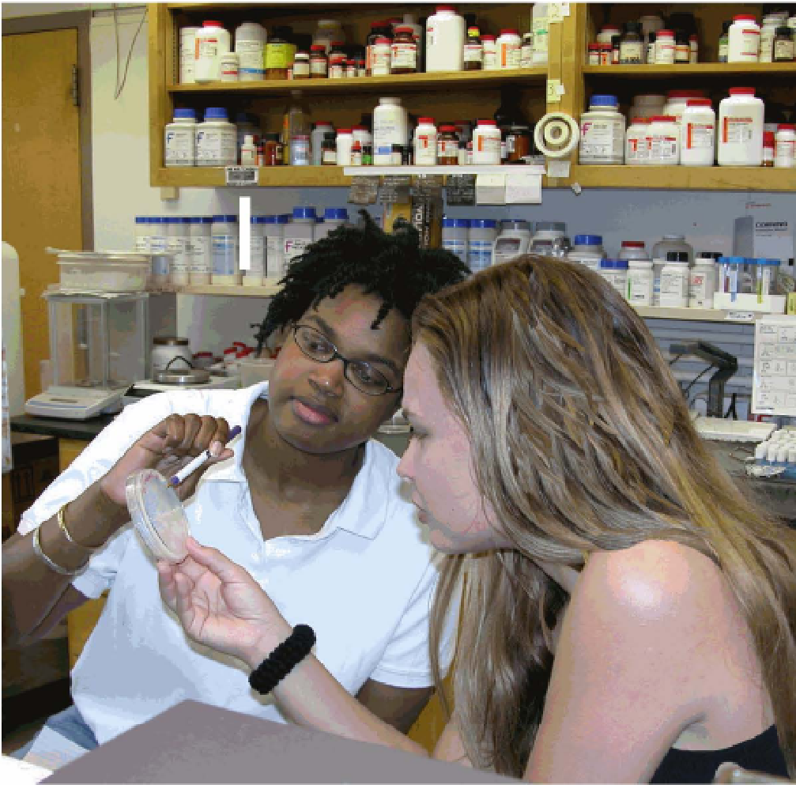
Mentoring is…
A collaborative learning relationship that proceeds through purposeful stages over time and has the primary goal of helping mentees acquire the essential competencies needed for success in their chosen career.
It includes using one’s own experience to guide another person through an experience that requires personal and intellectual growth and development.

Slide 3





Mentoring is a collaborative effort
Mentor
Mentee
Peers
Thesis committee
Environment/
Community
TRADITIONAL MENTORING
GROUP MENTORING
PEER MENTORING

Slide 4
Goals of Mentoring
SHOULD BE DEFINED BY MENTEE: MENTOR INTERACTION
IN GENERAL
EVALUATE CAREER GOALS
ATTAIN TECHNICAL SKILLS NEEDED FOR YOUR CAREER GOALS
GAIN EXPERIENCES NEEDED FOR FUTURE CAREER
DEVELOP PROFESSIONAL SKILLS FOR CHOSEN CAREER
REVISITED AND ASSESSED REGULARLY

Slide 5
KEYS TO BEING EFFECTIVELY MENTORED
EFFECTIVE COMMUNICATION
ALIGNING EXPECTATIONS
BUILD RESEARCH SELF-EFFICACY
ACHIEVE INDEPENDENCE
ACHIEVE WORK/LIFE INTEGRATION
ADDRESS EQUITY AND INCLUSION
SEEK PROFESSIONAL DEVELOPMENT

Slide 6
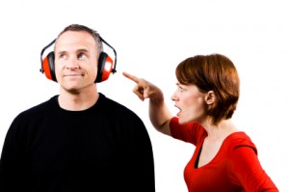
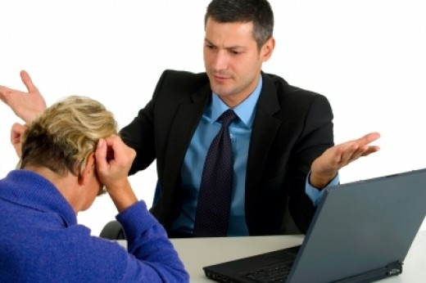
Enhancing Communications
Ineffective communication is at the root of many mentoring problems
Important to recognize your own communication style and that of your mentor
Recognize the need to adapt your style as needed to ensure most effective communications

Slide 7
Barriers to Effective Communication
Assumptions
Different personalities/communication styles
Letting items linger too long without discussion
Vague expectations
Lack of cultural capital
Cultural differences in communication styles

Slide 8
EFFECTIVE COMMUNICATION
RECOGNIZE INDIVIDUALS HAVE DIFFERENT STYLES
AFFECTED BY BACKGROUND, POWER DYNAMICS, OUTSIDE INFLUENCES,
ACCEPT AND IMPLEMENT CONSTRUCTIVE FEEDBACK
USE MUTLIPLE MODES OF COMMUNICATION
DIRECT
DISTANT
WRITTEN
VERBAL

Slide 9
Effective Communication
Strategies
Identify
Identify your and your mentor’s preferred style of communication
Determine
Determine mentor’s and your preferred medium for communication
Track and share
Track and share progress toward goals
Prepare
Prepare for each meeting
State at the start what you want to get out of it
Let your mentor know what you need
Establish
Establish working communication medium for you and your mentor

Slide 10
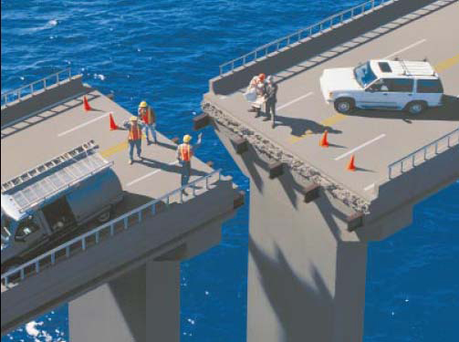
Mentor/Mentee Expectation Alignment
Key to a Successful Mentoring Relationship

Slide 11
How do you know when you don’t have alignment?
Mentor does not respond to emails / does not find the time to meet
Mentee does not follow through on deadlines
Mentor does most of the talking and direction-setting during mentoring meetings
Mentee or mentor dreads mentoring meetings
Mentor or mentee avoid each other
Mismatch of mentor and mentee expectations.

Slide 12
Underlying causes of misaligned expectations
Generational
Positionality
Geography
Components of Personal identity
Experiences
Mindset
Power Dynamics

Slide 13
Articulating Expectations
What am I looking for from my mentor relationship(s)?
What do I expect from my mentors and what do they expect from me?
How do my mentors know what I am expecting?
Have we explicitly discussed these questions? If not, why?

Slide 14
Approaches to alignment of expectations
Establish
Establish regular meeting schedules
Set
Set your agenda for each meeting
Establish
Establish your anticipated milestones and deliverables and request feedback
Leverage
Leverage the opportunity of using your IDPs to establish expectations

Slide 15

ALIGN EXPECTATIONS –Individualized Development Plan
UP FRONT ASSESSMENT:
  WHAT IS NEEDED TO ACHIEVE YOUR GOAL?
  WHAT ARE YOUR UNIQUE NEEDS AS A MENTEE?
    SCIENTIFIC SKILLS
    PROFESSIONAL SKILLS
    CAREER SKILLS
    SUPPORT
ESTABLISH MUTUATLLY AGREEABLE AND BENEFICIAL EXPECTATIONS
COMMUNICATE THE EXPECTATIONS
ALIGN EXPECTATIONS BETWEEN MENTOR AND MENTEE
REVISIT EXPECTATIONS AND ADJUST WITH MENTEE GROWTH

Slide 16
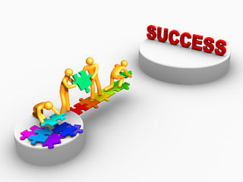
What Expectations?
  Professional networking
  Work/life integration
  Developing a career development plan
  Additional education/training needed
Topics to discuss during early conversations
  Short and long-term goals
  Areas of interest
  Communications styles
  Meeting schedules
  Timeline and milestones
  Identifying others involved

Slide 17
BUILD SELF-EFFICACY
SELF-PERCEIVED CONFIDENCE THAT A GOAL IS ACHIEVABLE
SOURCES OF SELF-EFFICACY
MASTERY – BY EXPERIENCE – “I’VE DONE THIS BEFORE”
SOCIAL – BY SUPPORT –” YOU CAN DO THIS”
VICARIOUS – BY EXAMPLE – “I’VE SEEN THIS DONE BEFORE”
EMOTIONAL/PHYSIOLOGICAL – BY EXCITEMENT – “DISCOVERY IN MY FIELD MAKES ME HAPPY
MENTORS SHOULD USE ALL OF THESE SOURCES TO INSTILL SELF-EFFICACY.
BUILD YOUR OWN SELF-EFFICACY
BUILD THE SELF-EFFICACY OF THOSE AROUND YOU

Slide 18
ACHIEVE INDEPENDENCE
MENTOR THESIS COMMITTEE PROGRAM
ELEMENTS OF INDEPENDENCE
ADVANCED KNOWLEDGE OF DISCIPLINE
CRITICAL EVALUATION OF LITERATURE
USE LITERATURE TO ANSWER QUESTIONS AND IDENTIFY KNOWLEDGE GAPS
DESIGN AND CONDUCT EXPERIMENTAL PLAN
WRITE UP A PRPOROSAL FOR THE EXPERIMENTAL PLAN
COMMUNICATE FINDINGS IN WRITTEN AND ORAL FORMATS
EACH MENTEE IS ON A DYNAMIC CONTINUUM THROUGHOUT THEIR TRAINING

Slide 19
ACHIEVE WORK/LIFE INTEGRATION
METHOD:
  BE REAL
  BE WHOLE
  BE INNOVATIVE
WORK
FAMILY
SELF
COMMUNITY
Notes:
Be Real: act with authenticity by clarifying what’s important
Often, we feel stressed at work because we find ourselves involved in many activities that we would rather not be doing, and not involved in the things that we find more important or interesting. This often results from our failing to define what is most important to us and the specific goals we have for ourselves in the four domains of our lives. Through a series of reflective exercises, participants will help articulate a personal vision statement for themselves, as well as clarify the specific goals they have for the four domains of their lives, their current success in achieving these goals, and opportunities for improvement.
Be Whole: act with integrity by respecting all your people
While we will not focus specifically on this aspect of the Total Leadership program during the mentor training, this part of the program enables you to clarify who the various people are that impact the work (e.g., department head, mentees, colleagues), family (e.g., spouse, children, parents) and community (highly variable and defined differently by each individual, e.g., friends, school community, sports leagues) domains of your lives, and to assess the expectations these people have for you. This is an important step in clarifying the goals you have in each domain and what it might take to achieve these goals to the satisfaction of those impacted by your actions. While we will not specifically cover this part of the program, you are encouraged to read chapters four and five in the book and conduct stakeholder interviews as described.
Be innovative: act with creativity by experimenting
Once you have clarified what is important to you, the goals you have in each domain of your life, and the opportunities you have identified for improving integration of these goals across domains, you will design an “experiment”- a small-scale change in your behavior that is designed to bring better alignment of the goals you have in all four domains. You will be divided into groups of 3 and work together to design your individual experiment and then over time, serve as a coach to one another providing feedback, advice and guidance on the progress of each other’s experiments.

Slide 20
Summary Core Tenets for Mentees
Know yourself – reflect and identify needs
Act with Intention
Communicate Effectively
Clarify Expectations
Enhance your Self Efficacy

Slide 21
Mentorship Workshop led by BGSA
Thanks to BGSA
  Gabriela Witek – Chair
  Lindsay Roth – Past Chair
  Rina Kim - Vice Chair Administrative Affairs
  Monika Eiva - Vice Chair of Academics
  Ana Defendini
  Stefan Peterson
  Vanessa Fleites
  Pankhuri Singhal
  Kahealani Uehara
  Janice Reynaga
  Kuldeep Yadav
  Laura Ohl

Slide 22
RESOURCES
BGS
  https://www.med.upenn.edu/bgs/documents/Responsibilitiesofthesismentorsthesisstudentsandthesisadvisorycommitteemembers_7-20-16_000.pdf
PENN VICE PROVOST FOR EDUCATION – ADVISING AND MENTORING PHD STUDENTS
  https://catalog.upenn.edu/graduate/academic-resources/advising-mentoring/
EVIDENCE BASED MENTORING
  https://www.nigms.nih.gov/training/strategicplanimplementationblueprint/pages/EvidenceBasedMentoring.aspx
CENTER FOR THE IMPROVEMENT OF MENTORED EXPERIENCES IN RESARCH (CIMER)
  https://cimerproject.org/#/
NATIONAL RESEARCH MENTORING NETWORK
  https://nrmnet.net/#undergradPopup
ENTERING MENTORING
  https://www.hhmi.org/sites/default/files/Educational%20Materials/Lab%20Management/entering_mentoring.pdf

Slide 23

Wishing you a journey full of Learning, Exploration, Actualization, Discovery and Science
Notes:
Wishing you a journey full of Learning, Exploration, and Discovery.

Slide 24
Being a Mentee - BGS Guidelines
Pursues scientific goals with intensity, motivation and creativity, working with integrity in all aspects of graduate training.
Takes ownership of her or his training, with guidance from the thesis advisor, thesis advisory committee, and relevant graduate group and BGS resources.
Reads relevant scientific literature.
Thinks intentionally and often about short-, mid-, and long-term training and development goals.
Meets regularly with the thesis advisor to provide updates on the results of activities, experiments, and progress in general.
Initiates meetings on a regular basis with her or his thesis advisory committee in accordance with graduate group policy, and will initiate meetings as needed or desired with members of this committee individually for guidance regarding research and other professional activities.
Strives to be a good lab citizen, for example by taking part in shared laboratory responsibilities, using laboratory resources carefully and frugally, and working collegially and respectfully with all laboratory personnel.
Attends and participates in laboratory meetings, and recognizes that seminars, journal clubs, and other professional activities encouraged or required by the thesis advisor, graduate group, or BGS are important to training.
Maintains a detailed, organized, and accurate laboratory notebook.
Complies with all institutional policies, including safe laboratory practices, responsible conduct of research, experimental design and transparency as it relates to reproducibility, and individual development plans.
Discusses policies on work hours, sick leave, and vacation with the thesis advisor.
Takes ownership of professional development, through completion of an IDP annually and with guidance from the thesis advisor, the thesis advisory committee, other mentors, BGS resources, and career counseling services.

Slide 25
BEING A MENTOR – BGS GUIDELINES
Encourages independence in the student in terms of scientific thought and process.
Is supportive, accessible, encouraging, respectful, and fosters open communication.
Ensures that the research environment is safe, equitable, and free from harassment and discrimination.
Models ethical behavior, and discusses ethical approaches in conducting the research.
Communicates expectations regarding work habits and behavior in the laboratory.
Works closely with the student to design a meaningful thesis project.
Provides consistent and constructive feedback about laboratory skills, writing, and presentations, being honest when performance does not meet expectations.
Encourages student presentations at local, national, and international conferences.
Acknowledges student contributions.
Facilitates timely publication of student research.
Pursues opportunities to secure resources necessary to provide stable financial support.
Prepares the student for her or his chosen career path by discussing goals and plans for achieving them.
Consults with the student in identifying a position upon graduation, and provides letters of recommendation that fully represent the student’s experience and accomplishments.

Slide 26
BEING A THESIS COMMITTEE MEMBER
Critical evaluation of the student’s scientific progress, and of the competencies that relate to scientific pursuit in general.
Feedback to the thesis mentor and/or student regarding feasibility of research goals and plans, especially when the proposed plan is incompatible with timely completion of the thesis.
Cross-checks on training in responsible conduct of research and experimental design as it relates to reproducibility, verifying that the lab notebook is complete and well-managed.
An active interest in the student’s professional development, using the student’s IDP as one point of discussion.
Interactions that promote open dialog on science, skills, interests, and aspirations.
A willingness to step in should problems in the dynamics between the student

